Slide 1

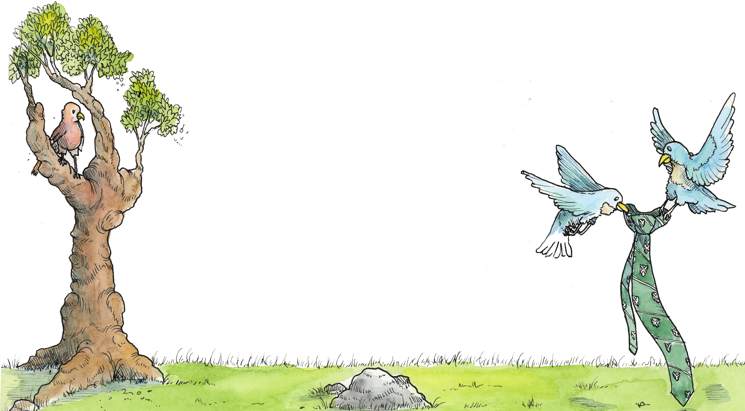
Year 4 to Year 5
Transition
Meeting
Tuesday 24th June 2025

Slide 2


Notes:
GCW

Slide 3



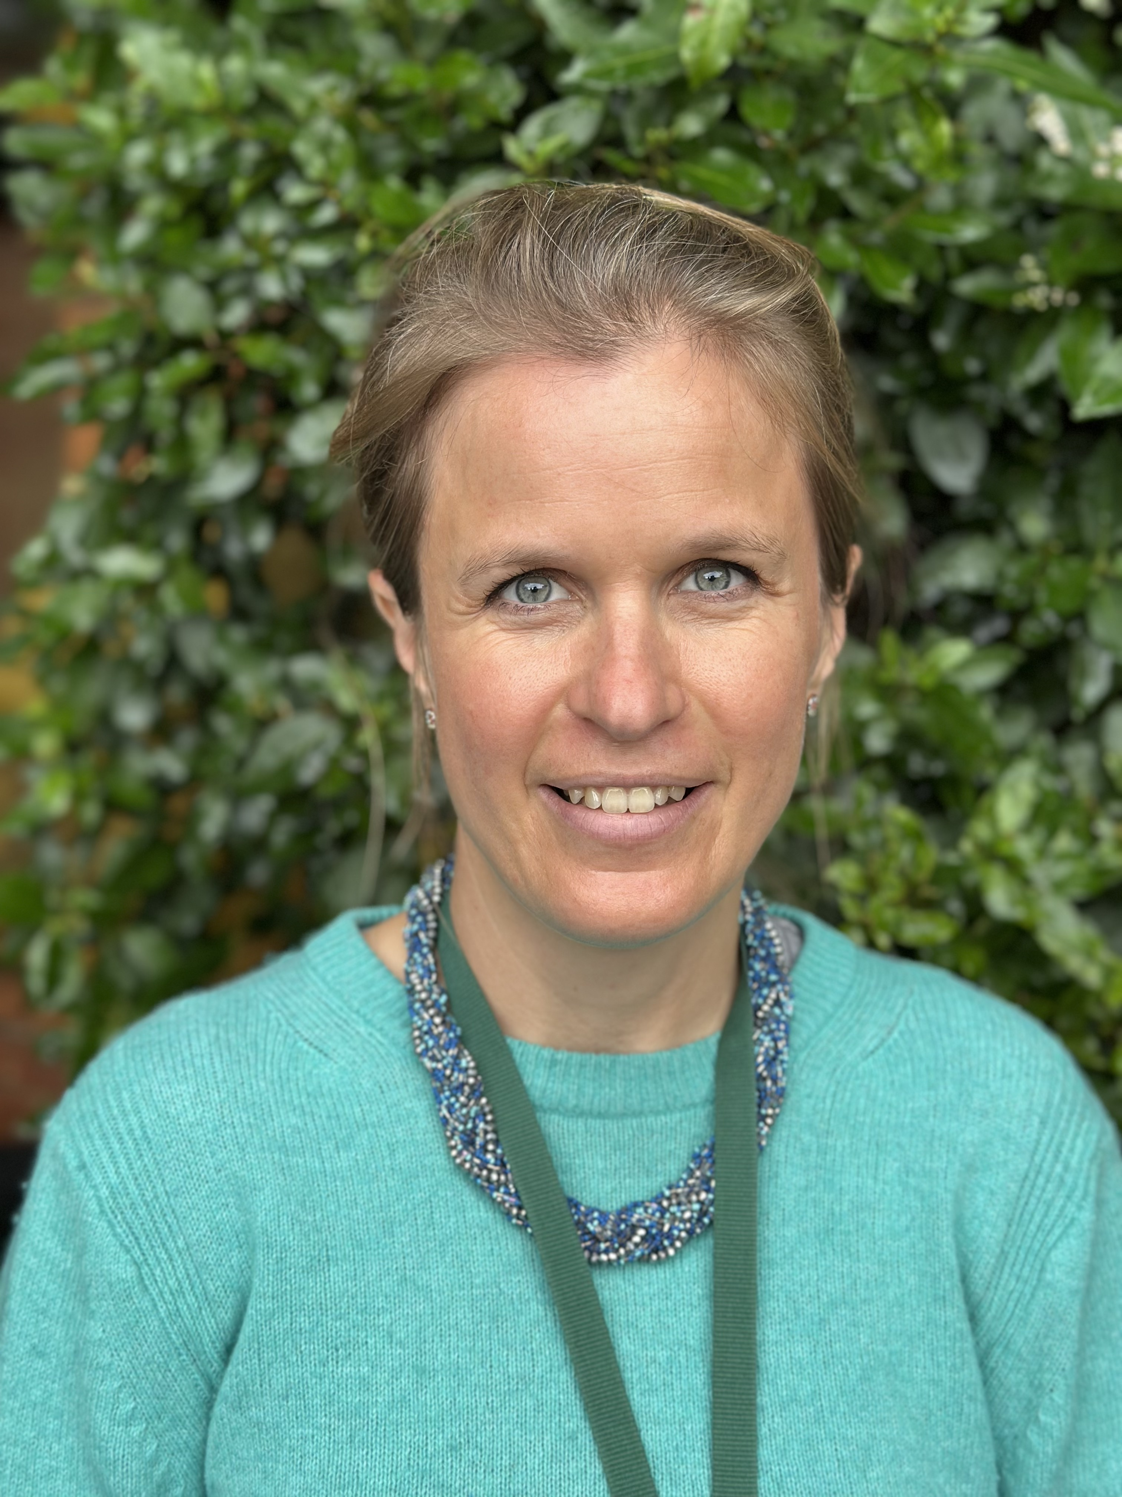

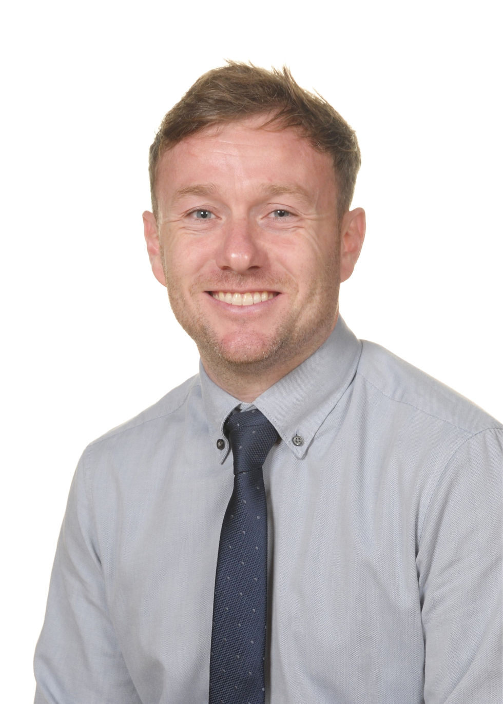

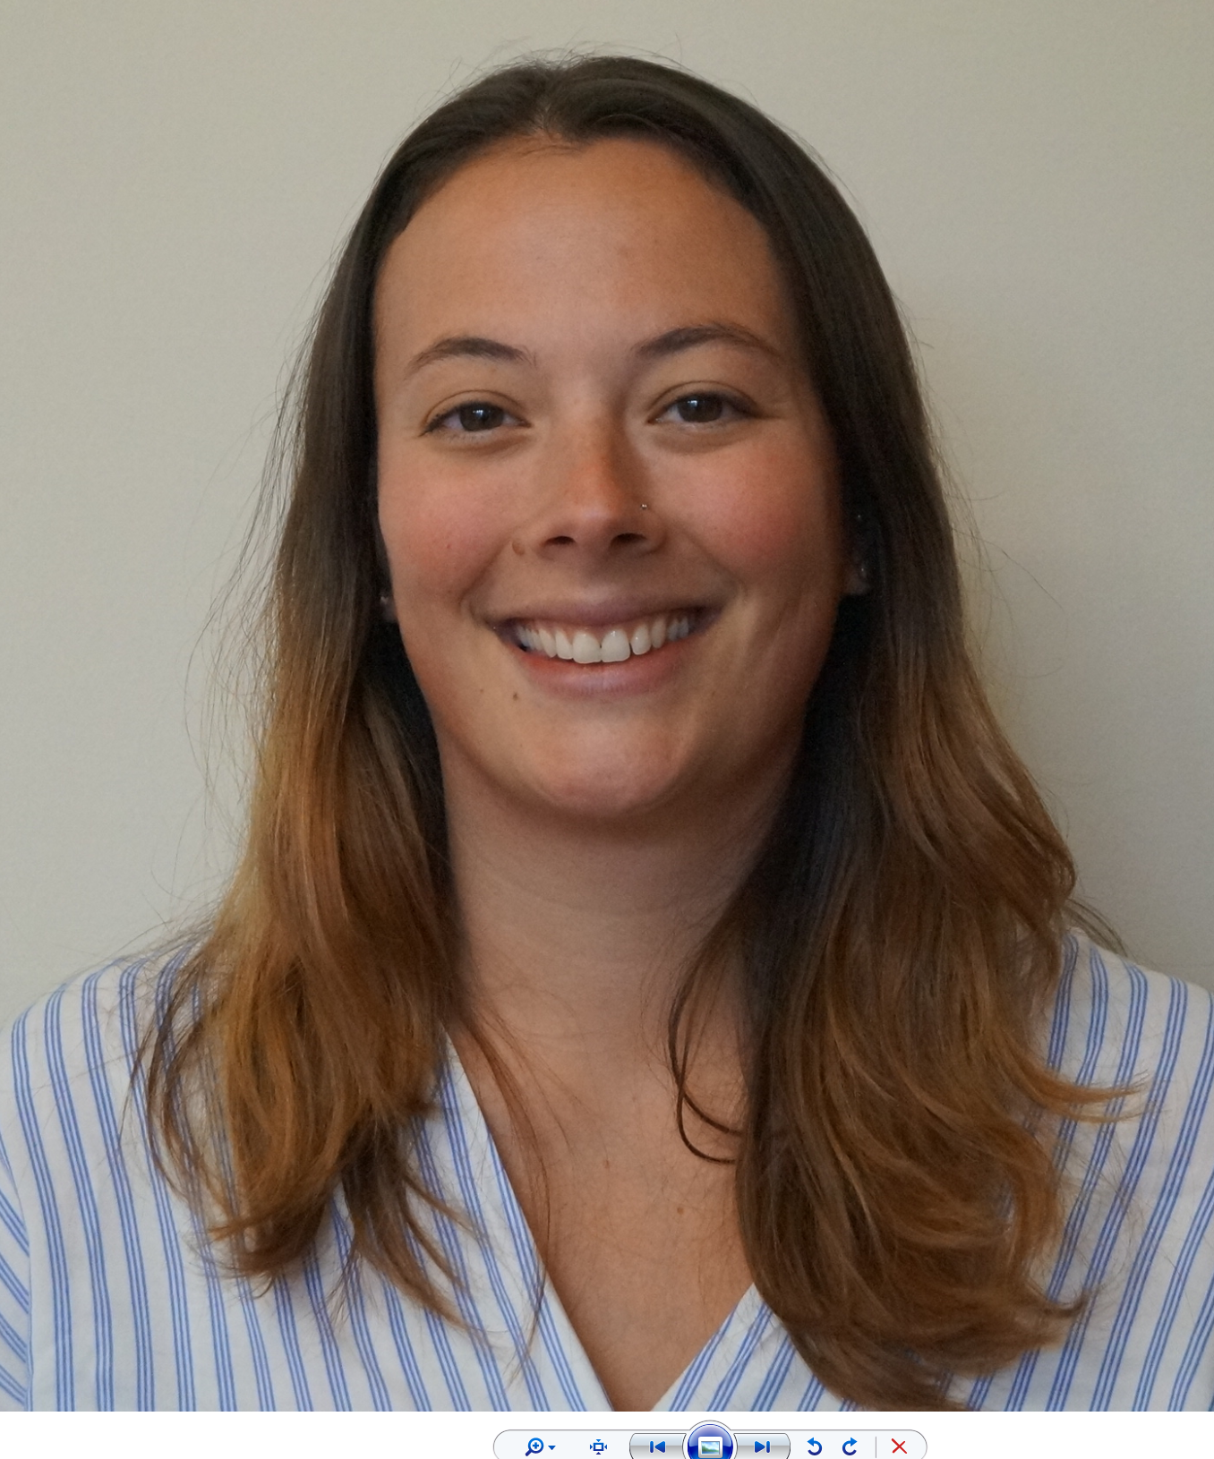

THE YEAR 5 TEAM
Mr Haig Howard
5B Form Tutor
Mr Richard Jones
Head of Middles/ 5W Form Tutor
Mrs Holly Burvill
5A Form Tutor
Mr Steve Gair
Deputy Head (Teaching and Learning)
Mrs George Weir
Head of Senior Schools
Mrs Catharine Preston
Deputy Head (Pupil Wellbeing)
Notes:
GCW

Slide 4

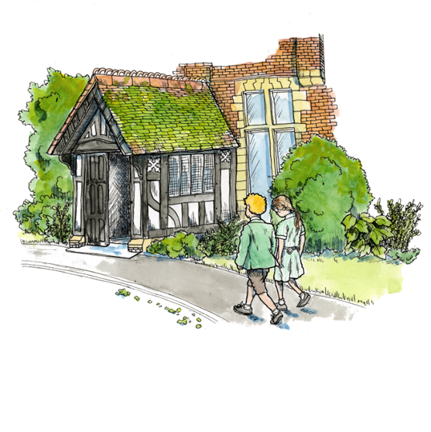
TOWARDS INDEPENDENCE
Subject specialist teaching.
Movement around the school.
Rucksacks
Form rooms and lockers
Study diaries.
Wednesday matches/ changing rooms/ equipment.
Bushcraft residential.
Notes:
GCW

Slide 5

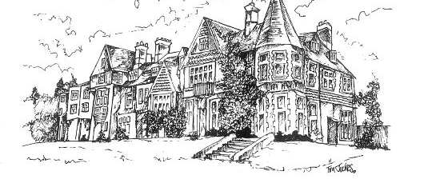
THE SCHOOL DAY
Drop off 8am, registration 8.15am
Breakfast available 7.30am daily.
Mon – Thursday school day ends at 5.15pm
Co-Curricular, QS and clubs available to 6pm.
Supper available at 6pm every day.
Wednesday matches, dependent on venue, team and sport.
Friday morning chapel
Notes:
Alex and Brodie

Slide 6


PASTORAL CARE
SUPPORT:
Bother Boxes within classrooms and on TEAMS
PSHE curriculum and Circle Time
Qualified ELSAs (Emotional Literacy Support Assistant)
Wellbeing Space during Breaks and Rests
CONCERNS:
Form Tutors
Head of Middles (Richard Jones)
Deputy Head Pupil Wellbeing (Catharine Preston)
Notes:
GCW

Slide 7

Transfer of Information
Pastoral
Progress
Targets
Support / interventions
Medical information
Notes:
Alex and Brodie

Slide 8
Year 5 Curriculum
English 5
Maths 5
Science 2
French 1.5
Latin 1
History 1.5
Geography 1.5
Religious Studies 1
Art 1
Drama 1
Music 1
ICT 1
PSHE 1
Senior School Preparation 1
Touch typing 0.5
Reading Period / QS 2
Co-curricular 2
Games (+ PE/swim) 5 + 1
Notes:
Alex and Brodie

Slide 9






Senior Schools
Advice
Practice (SSP)
Interview
References
Pre-Tests
Thursday 25th September 5.15
Notes:
Alex and Brodie

Slide 10

Senior School Preparation (SSP)
One lesson per week.
Verbal reasoning, non-verbal reasoning, philosophy, current affairs and team building.
Continue using Century – will start to include verbal and non-verbal reasoning.
Notes:
Alex and Brodie

Slide 11
Prep
Prep is set as per the prep timetable
Prep recorded on Teams and in the pupil’s study diary.
30 minute weekly prep in English and Maths.
15 minute weekly learning prep in French and Latin.
Notes:
Alex and Brodie

Slide 12
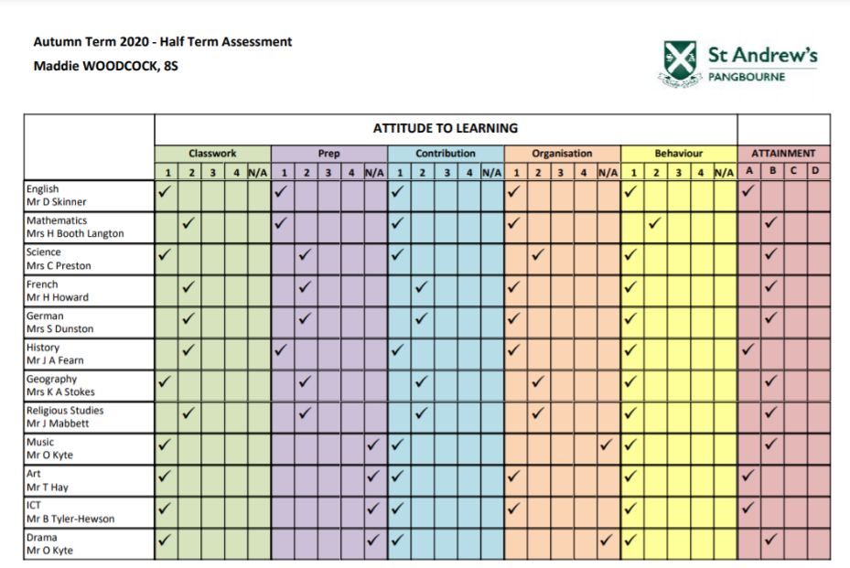
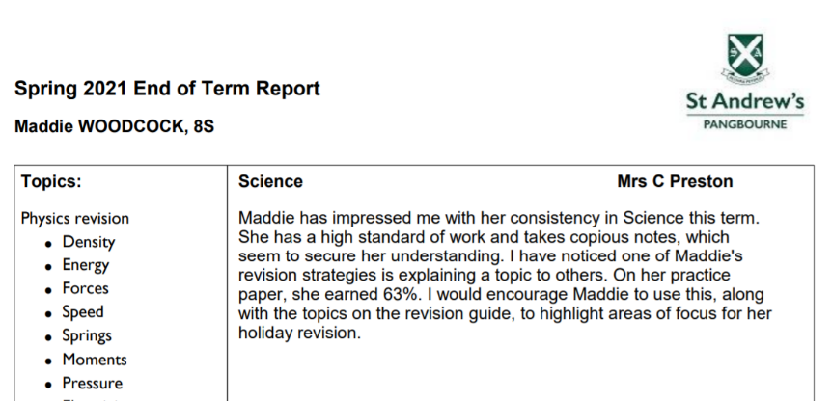
Reporting to Parents
Half Term Assessment Grades (HTAs)
Termly Reports
Parent Teacher Evenings
Notes:
Alex and Brodie

Slide 13
Helping at home
Bedtimes
News (The Week Junior/ Newsround)
Screen Time
Reading
Times Tables
Notes:
Alex and Brodie

Slide 14
ANY QUESTIONS?
Notes:
Alex and Brodie

